Slide 1
Team 6
Rui Wang, Carol Cheng, Hua Tang, Yan Zhao, Victor Zhao

Slide 2
Functional Requirements
Extract questions from JSON file
Organize and store questions into CAS
Use GoPubMed client
Concepts retrieval
Documents retrieval
Triples retrieval
Snippets retrieval
Classify snippets into categories
Exact answer generation
Evaluate the system

Slide 3
Structural Requirements
Archetype and type system
Descriptors
JSON file collection reader
Aggregate analysis engine
Question annotator
Concept annotator
Document annotator
Triple annotator
Snippet annotator
Evaluation CAS consumer

Slide 4
Vision
Express in one or two paragraphs what your system will be able to do when it is done

Slide 5
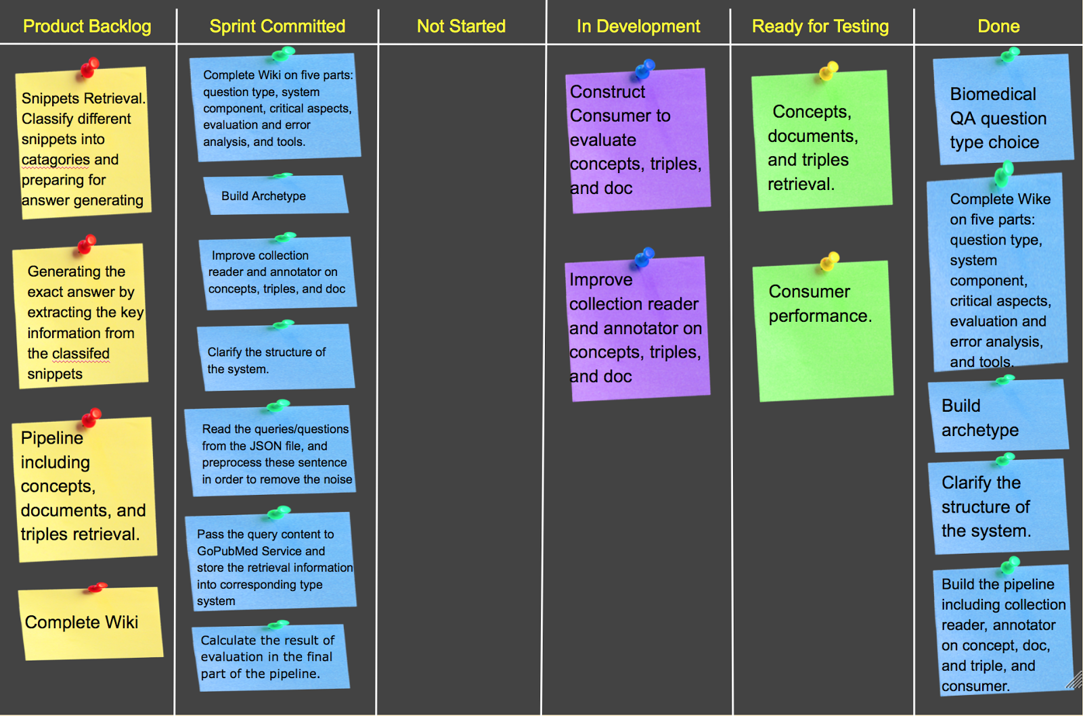
Story Wall
https://docs.google.com/a/andrew.cmu.edu/drawings/d/15pioPQz4cME4XDfI-pWJT-ZpDoZg81HkAyNswWoAEeQ
Notes:
Product Backlog:
Items developer will attempt to convert to working product during the Sprint, these are tasks given by the product owner.
Sprint Backlog Committed:
committed PBIs negotiated between the team and the Product Owner during the Sprint Planning Meeting.
These items can be fixed during Sprint Execution, and is used to Initiaizel tasks are identified by the team
Trace of different tasks in detail to show the progress of the sprint, making them visible to the team.

Slide 6
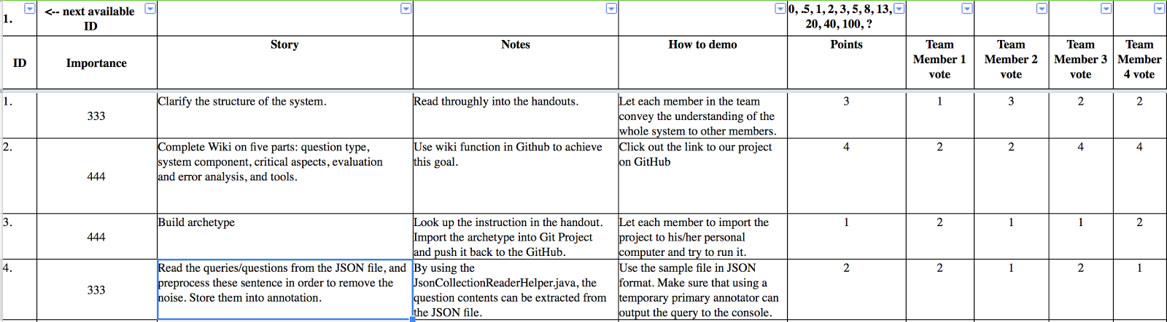
Product Backlog
Notes:
By Victor:
I just add 4 items of stories in the Product Backlog sheet. Please comment on it.

Slide 7
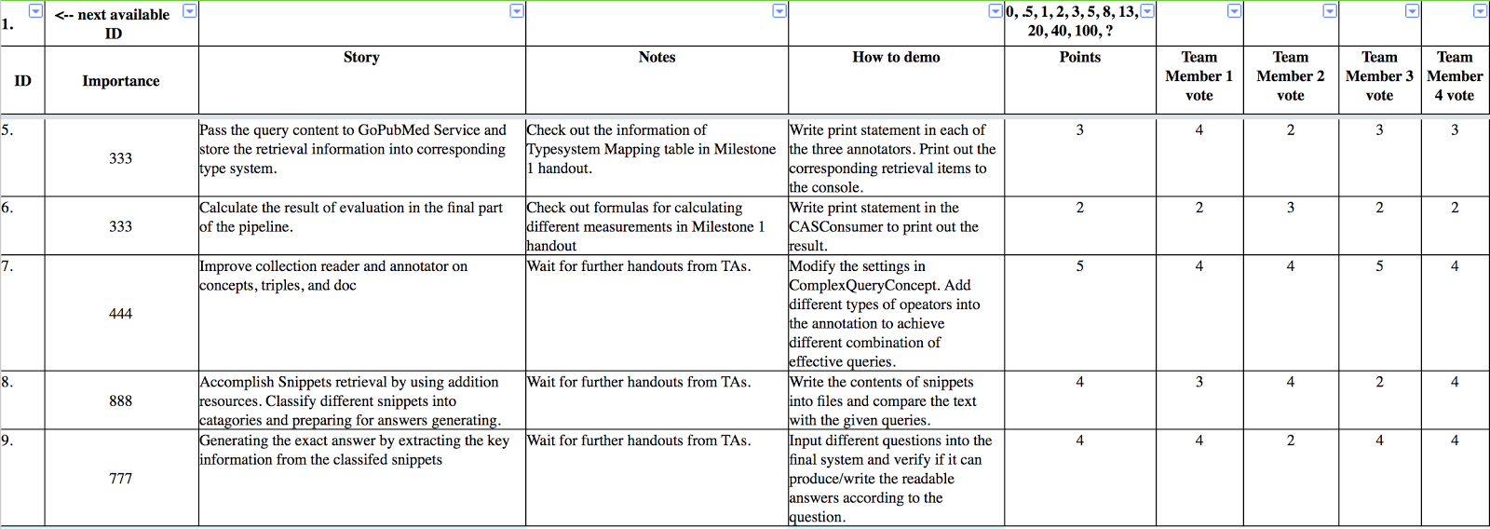
Product Backlog

